Slide 1
Android develop and debug methods

Slide 2
Table of contents
System.out.print
Log and Logcat
Debug and breakpoints
Divide and conquer

Slide 3
System.out.print
System.out.print
System.out.println
…

Slide 4
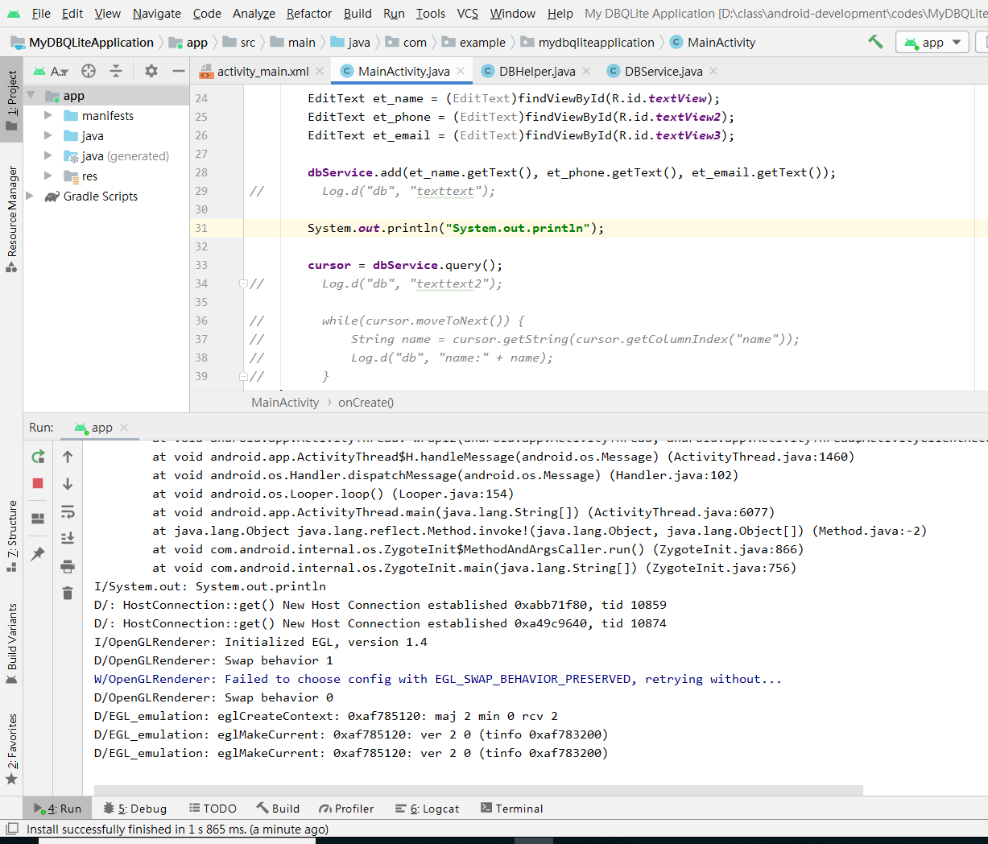

Slide 5
Log and Logcat
Log is API for sending log output
Log.v(), Log.d(), Log.i(), Log.w(), Log.e()
view the logs in logcat
Tip: A good convention is to declare a TAG constant in your class

Slide 6
Log types
The order in terms of verbosity, from least to most is ERROR, WARN, INFO, DEBUG, VERBOSE.
Verbose should never be compiled into an application except during development.
Debug logs are compiled in but stripped at runtime
Error, warning and info logs are always kept.

Slide 7
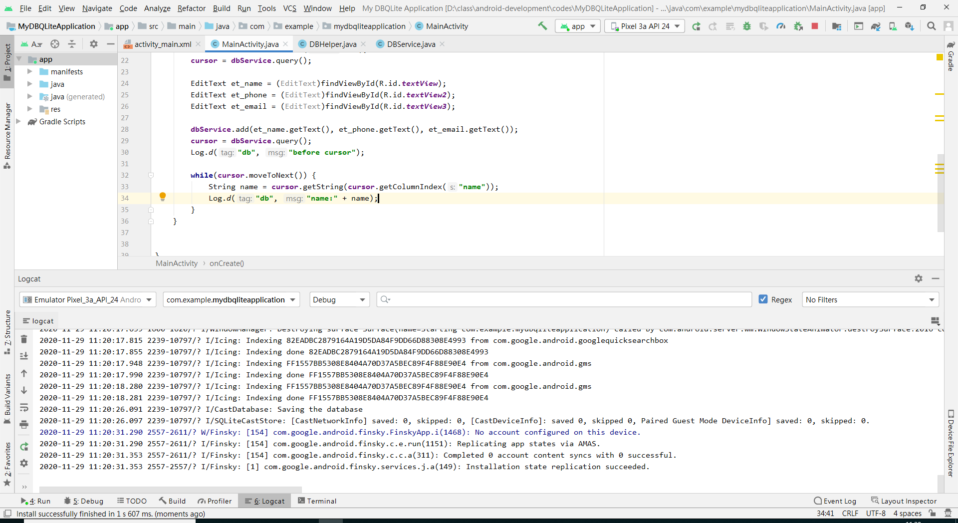

Slide 8
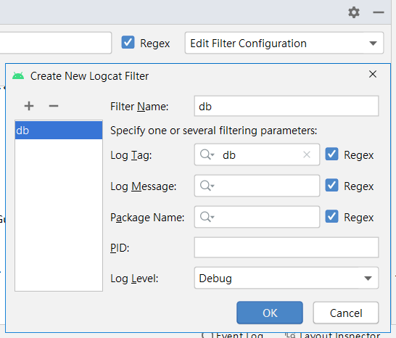
Logcat filter

Slide 9
Debug and breakpoints
Just like in plain java and c/c++

Slide 10
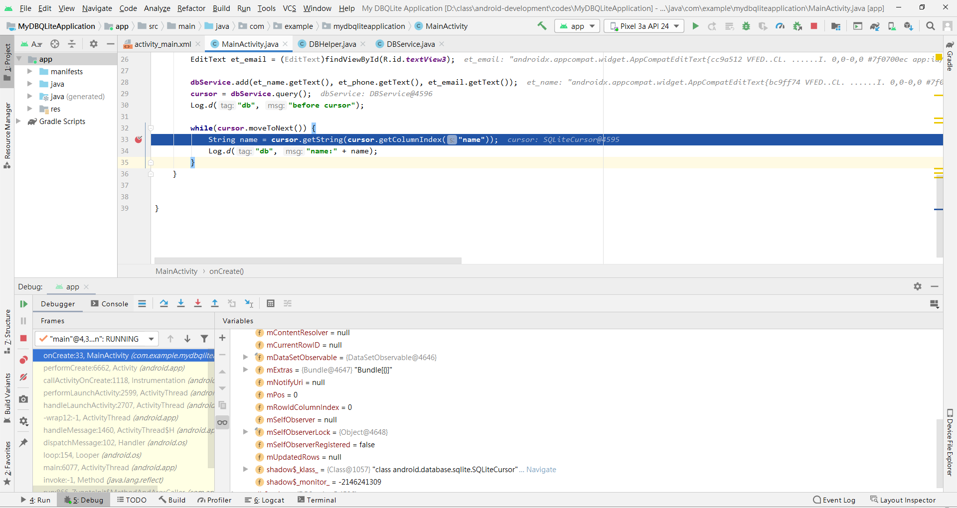

Slide 11
Divide and conquer
It is a effective way to solve big and complex problems
Try to divide the problem to sub-problems until you can handle

Slide 12
DB example
All files
DBService.java
DBHelper.java
ColleagueAdapter.java
MainActivity.java
How to divide the problem?

Slide 13
Remember and use it whenever possible

